Slide 1


Pundra University of Science & Technology
Presented by:
Md. Meahadi Hasan
Program: B.Sc in CSE
ID: 0322310105101034
Session: Spring-2025
Batch: 22ⁿᵈ
Topic: Internet of Things (IoT): Connecting the World Intelligently

Slide 2

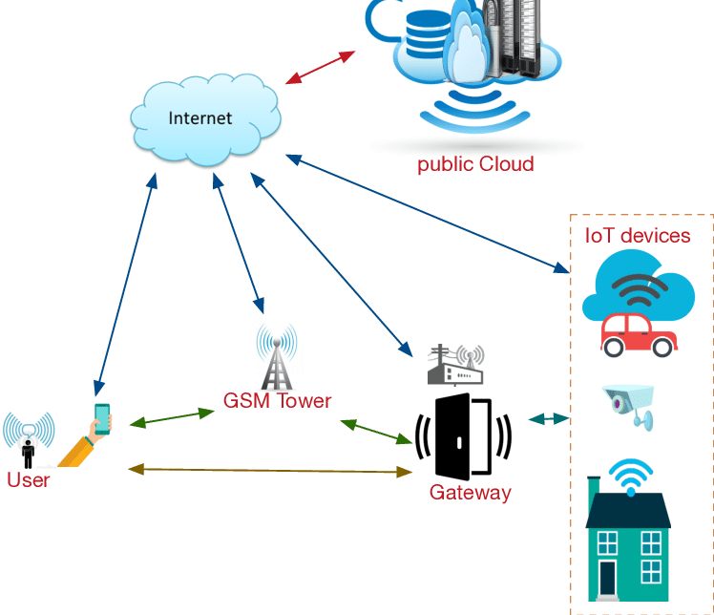
Introduction
The Internet of Things is a network of interconnected smart devices. These devices communicate and share data automatically. Sensors, software, and connectivity enable real-time interactions. IoT bridges the physical and digital worlds.
Interconnected Devices
Data Exchange
A network of physical objects connected via the internet.
Devices communicate and share data without intervention.
Digital Bridge
Connects the physical and digital worlds.
1
Notes:
2

Slide 3
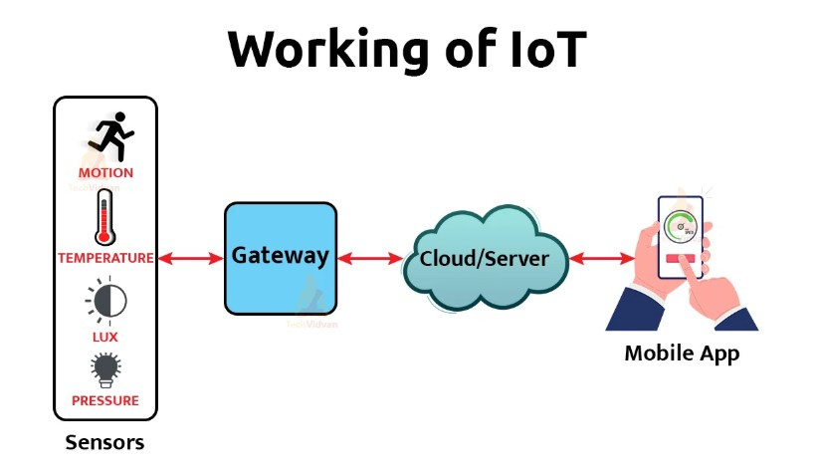
Working Procedure of IoT
1
Devices/Sensors: Collect data from the environment.
2
Connectivity: Data is transferred using Wi-Fi, Bluetooth, 4G, etc.
3
Data Processing: Cloud or local servers analyze the data.
4
Action: A response is generated, like sending an alert or turning on a device.
2
Notes:
3

Slide 4

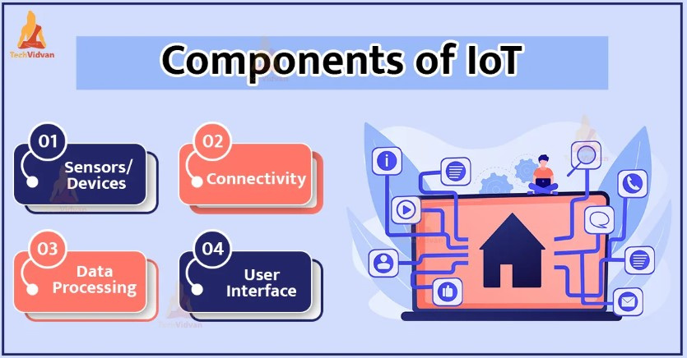


Key Components of IoT
IoT architecture include sensors, connectivity, and cloud infrastructure.
These components work together to create a functional IoT ecosystem.
Sensors and Actuators
Collect and respond to data.
Connectivity
Uses 4G, WiFi, and Bluetooth.
Cloud Computing
Provides infrastructure.
3
Notes:
4

Slide 5

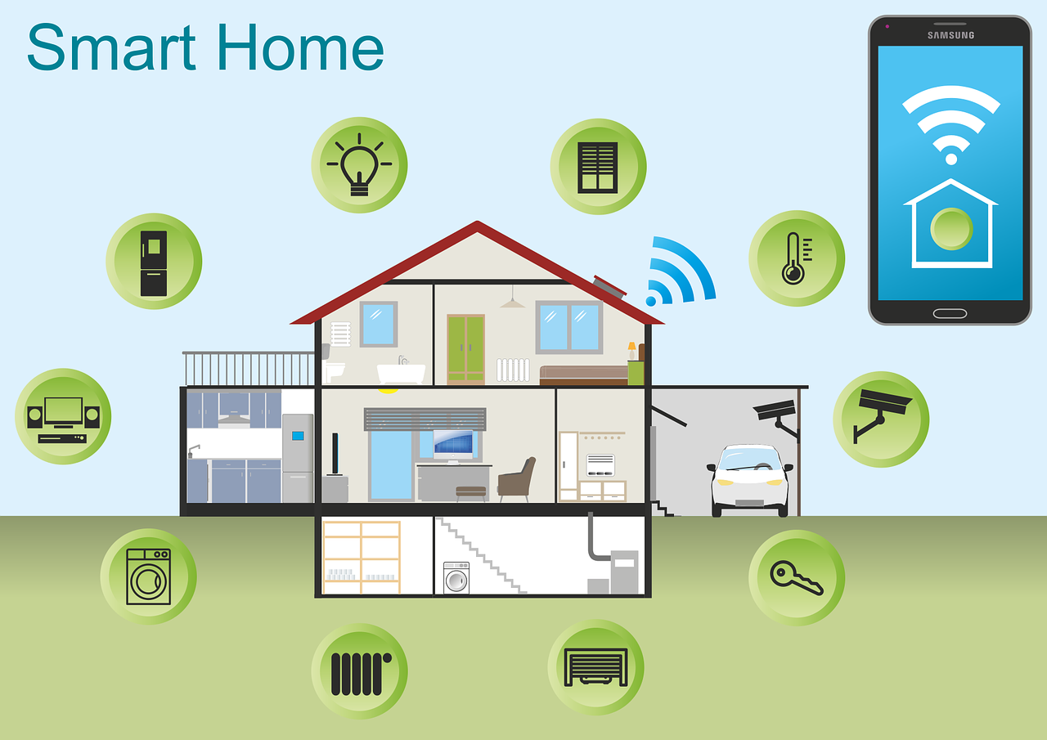
Applications of IoT
Healthcare IoT
Smart Home IoT
Healthcare IoT enables remote patient monitoring, wearable health trackers, smart medical equipment, personalized treatment, and potential 25% cost reduction in healthcare.
Smart Home IoT connects devices such as lights, thermostats, and security systems, enabling remote control, automation, and real-time monitoring to enhance comfort, energy efficiency, and home security.
4
Notes:
5

Slide 6
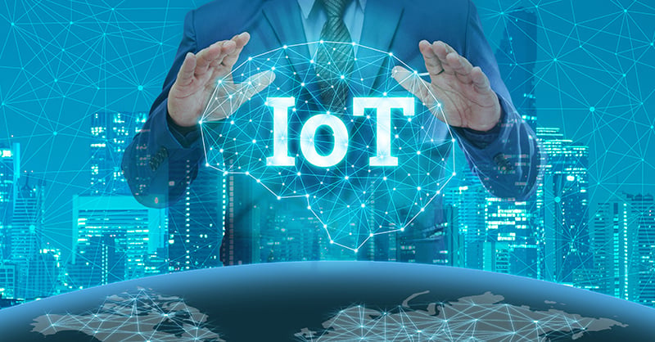
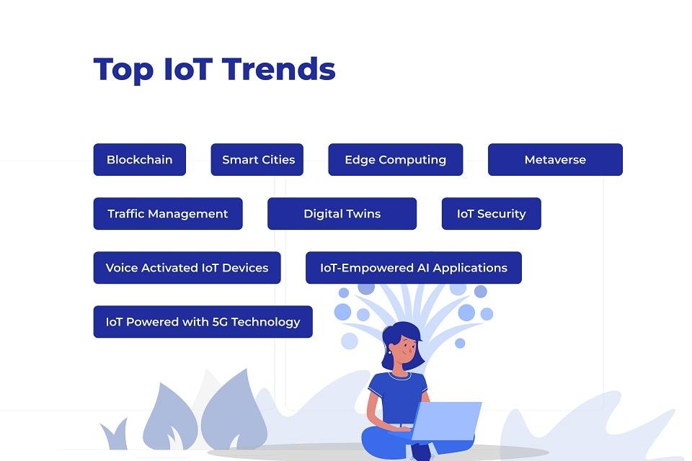
Future Trends in IoT
Edge computing, AI, and machine learning are enhancing IoT capabilities, while 5G networks expand possibilities for sustainable and green technologies.
Edge Computing
1
AI Enhancement
2
5G Networks
3
5
Notes:
7

Slide 7
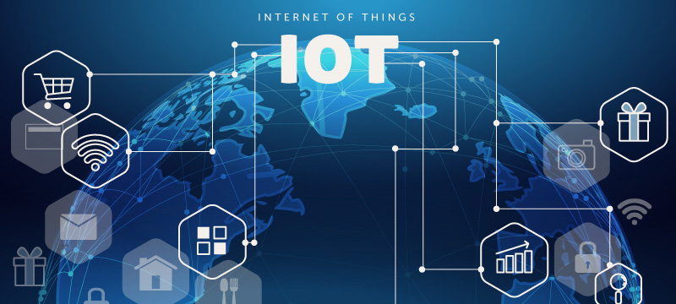
Conclusion
The Internet of Things (IoT) is revolutionizing the way we interact with technology by creating smarter homes, industries, cities, and healthcare systems. It enables real-time monitoring, automation, and decision-making across various sectors.
6
Notes:
8

